Slide 1


Robotics Workshop Week 9 Intro to Electronics
Notes:
Hello everyone, its great to see so many of you here at this first session.
My name is Lukas, my role in HackSussex, which is the main computer science society here, is to organize and create these robotics workshops. We organize hackathons, coding competitions, socials, and various workshops including these.
Now, because this is the first session ill give a short description about what you can expect from attending.
We’ll take you through the basics of electronics, mechanics and robotics, quickly building your knowledge on this under-represented yet impressive area of Engineering and Computing. It will run for the whole academic year with increasingly bigger and better workshops.
The workshops assume you don’t know anything, so it doesn’t matter if you have never used this hardware or software before, and if you have you certainly wont be getting bored and will still learn something new every session.
As you have probably seen on the posters around campus, this is a hands on workshop, so only a small amount of time is spent teaching via presentation.
Instead you get custom worksheets that I’ve spent countless hours creating and improving for a much more involved experience.
A normal 2 hour session would generally involve me talking for 10-15 minutes at the start, throwing a bunch of information at you in the hopes that it helps you understand the worksheet better.
Then, in groups 2 – 4 you’d go through the worksheet using the provided hardware. You’re working in groups so you can share your knowledge, meet new people and solve any problems you come into collectively.
While your working together, we’ll be going between groups to provide help where needed and to get to know you better.
The last 20 minutes or so will involve packing up the equipment and having a short Q&A about anything related.
And with that out of the way, lets get started. In today’s workshop you will be introduced to some basic electronics and micro-controllers.

Slide 2
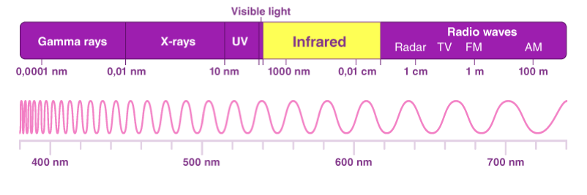
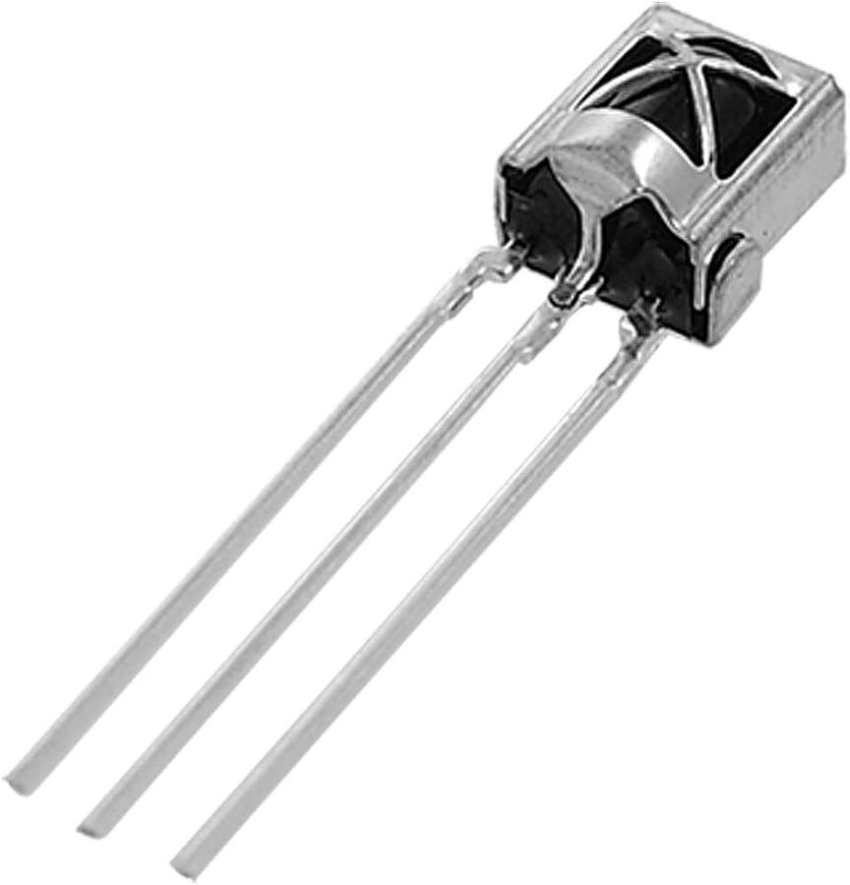
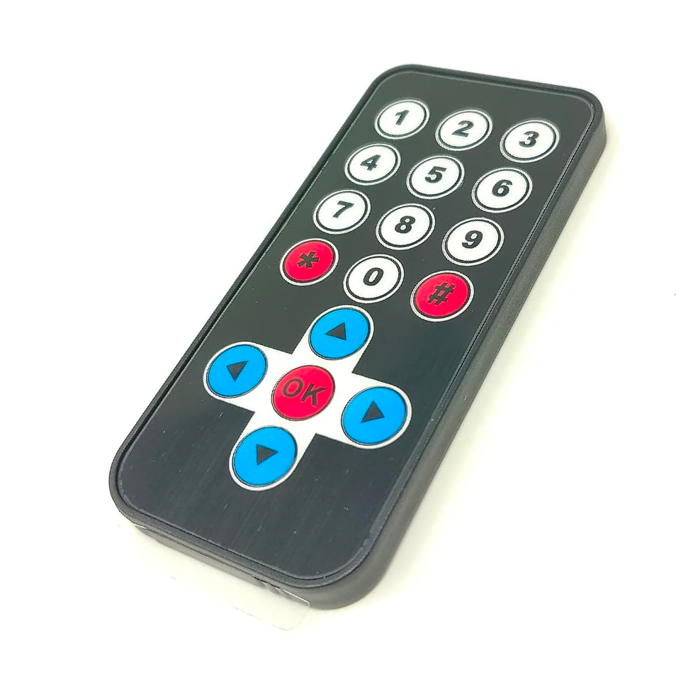
Infrared
Electromagnetic wave between 780 nm and 1 mm / 300 GHz to 400 THz
Remote sends data signals to receiver
Needs line of sight
Notes:
In electronics you have 3 variables key variables to think about when creating circuits. Current, which is a measure of the rate of flow of charge through a wire, electrons hold this charge, so current is a measure of the rate of flow of electrons through a wire.
Voltage, this is a measure of the potential for current to flow through a wire, analogous to the potential a rock has at the top of a hill to roll down.
And resistance, simply a property that resists the flow of charge in a wire.
These 3 factors are all related to each other through Ohms law. Where voltage equals current multiplied by resistance.

Slide 3

Github
The place where code lives
Access through a convenient website or the command line
Light mode is best mode
Notes:
This is a basic circuit diagram, on the top you have a symbol representing a switch, currently the switch is open so no current can flow.
On the left is a battery/power supply giving 3.3v, on the bottom is a resistor and on the right is an LED.
LED stands for light emitting diode, diodes are electrical components that only allow electricity to flow in one direction, and with it being a light emitting diode it only emits light when its powered in one direction.

Slide 4
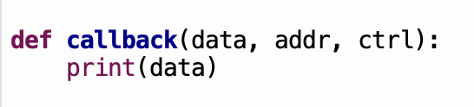
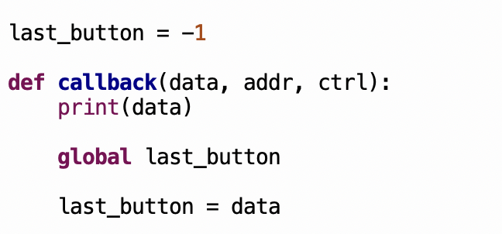
Python Functions and Globals
A function is code we can “call” to reuse again and again
The “parameters” on the top line are just variables we can use and reassign as normal
Global Variables
To use a variable from outside of our function we need to declare it as a global.
Light mode is best mode
Notes:
This is a basic circuit diagram, on the top you have a symbol representing a switch, currently the switch is open so no current can flow.
On the left is a battery/power supply giving 3.3v, on the bottom is a resistor and on the right is an LED.
LED stands for light emitting diode, diodes are electrical components that only allow electricity to flow in one direction, and with it being a light emitting diode it only emits light when its powered in one direction.

Slide 5
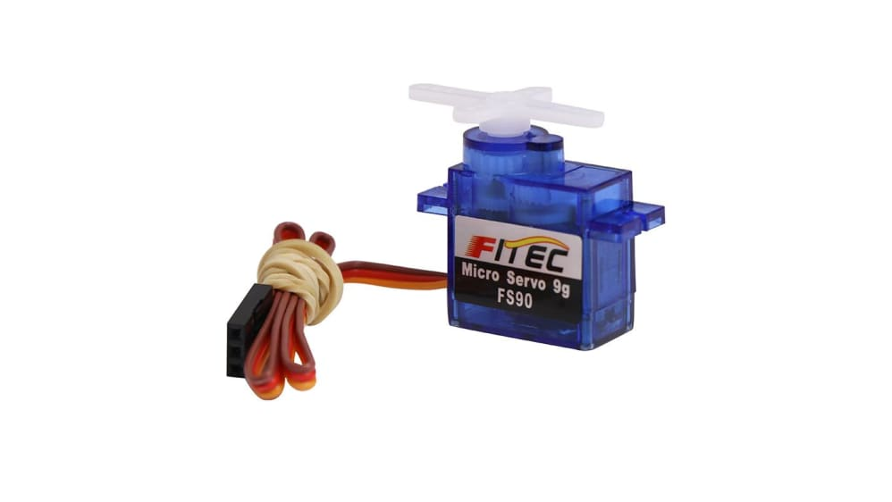
Servos Again
You got this. Remember week 2?
Notes:
() – brackets indicate in person pointing out.
How do you use a Pi Pico?
On the hardware side you can connect the Pi Pico’s pins (all of these) to various devices with wires, however for most workshops your Pi Pico will be on a bread board (one of these).
These allow you to more easily connect and mount various electrical components together. They work by creating an electrical connection between pins plugged into the same row or column.
(all of these pins are electrically connected in a column, but these pins which are also connected in a column are not electrically connected to the coulomb above, and that’s the same across the whole center section)
(for the 2 rows at the top and bottom, these generally are used for power and ground because each row is electrically connected across the whole board)
Now on the software side when you connect your Pi Pico to a computer using the provided cables, and launch Thonny, you can write a program for the Pi Pico in Python then upload and run the code.
The worksheets have detailed instructions on how to connect and program the Pi Pico with Thonny so I wont go into any more detail here.

